Slide 1
INTERNET HISTORY,TECHNOLOGY AND SECURITY
NAME-DIVYA GUPTA
COURSE-BTECH(CSE)

Slide 2

The University of Michigan frequently referred to simply as Michigan, is located in Ann Arbor, Michigan, United States.

Slide 3
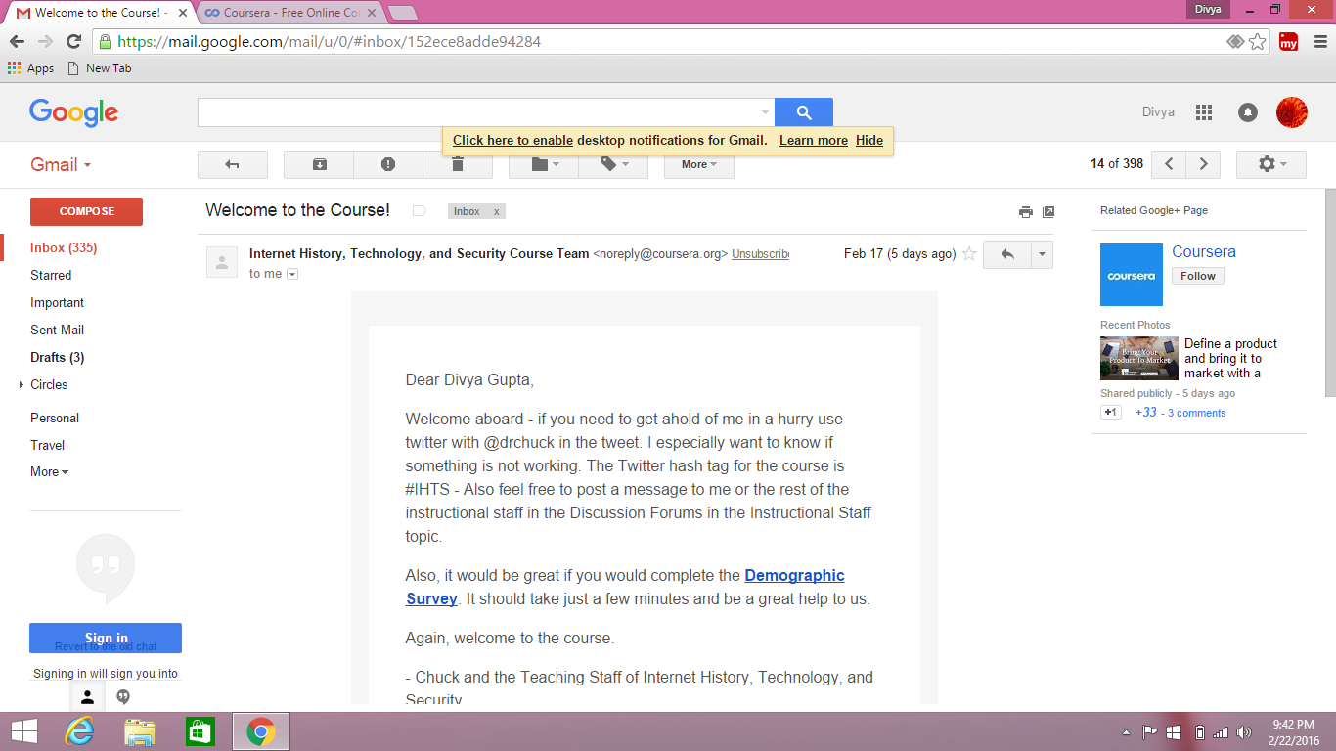

Slide 4
INTRODUCTION
This course will open up the Internet and show how it was created, who created it and how it works. Along the way we will meet many of the innovators who developed the Internet and how the web came into existence.

Slide 5
After this course , I was better informed about how internet came and important technological issues . At a minimum, I have been a much wiser network citizen!

Slide 6
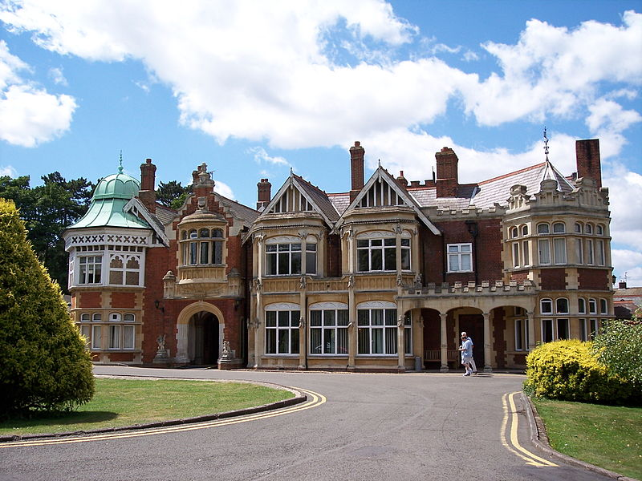

Slide 7
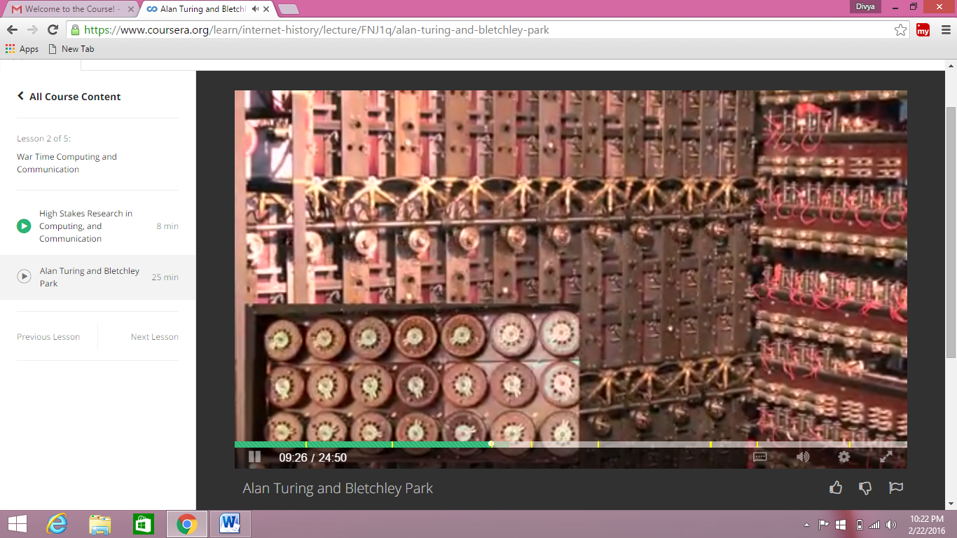
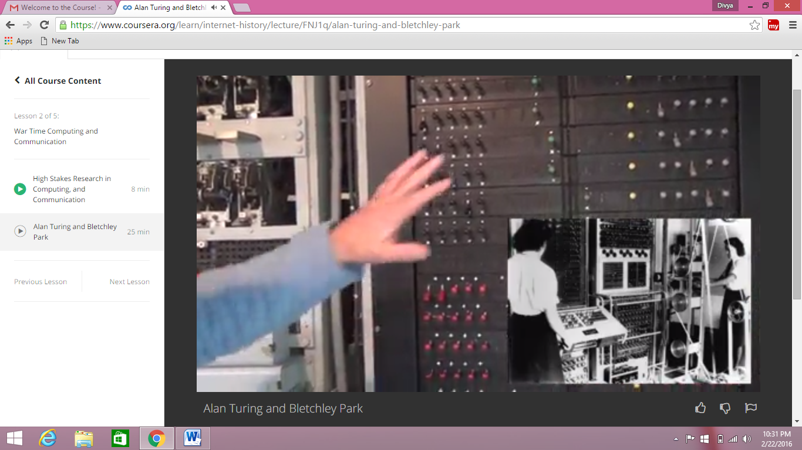
Bletchley Park , England
• Top secret code breaking effort in 1938 but now as a museum
• 10,000 people at the peak (team effort) during world war 2nd
• BOMBE: Mechanical Computer
• Colossus: Electronic Computer

Slide 8
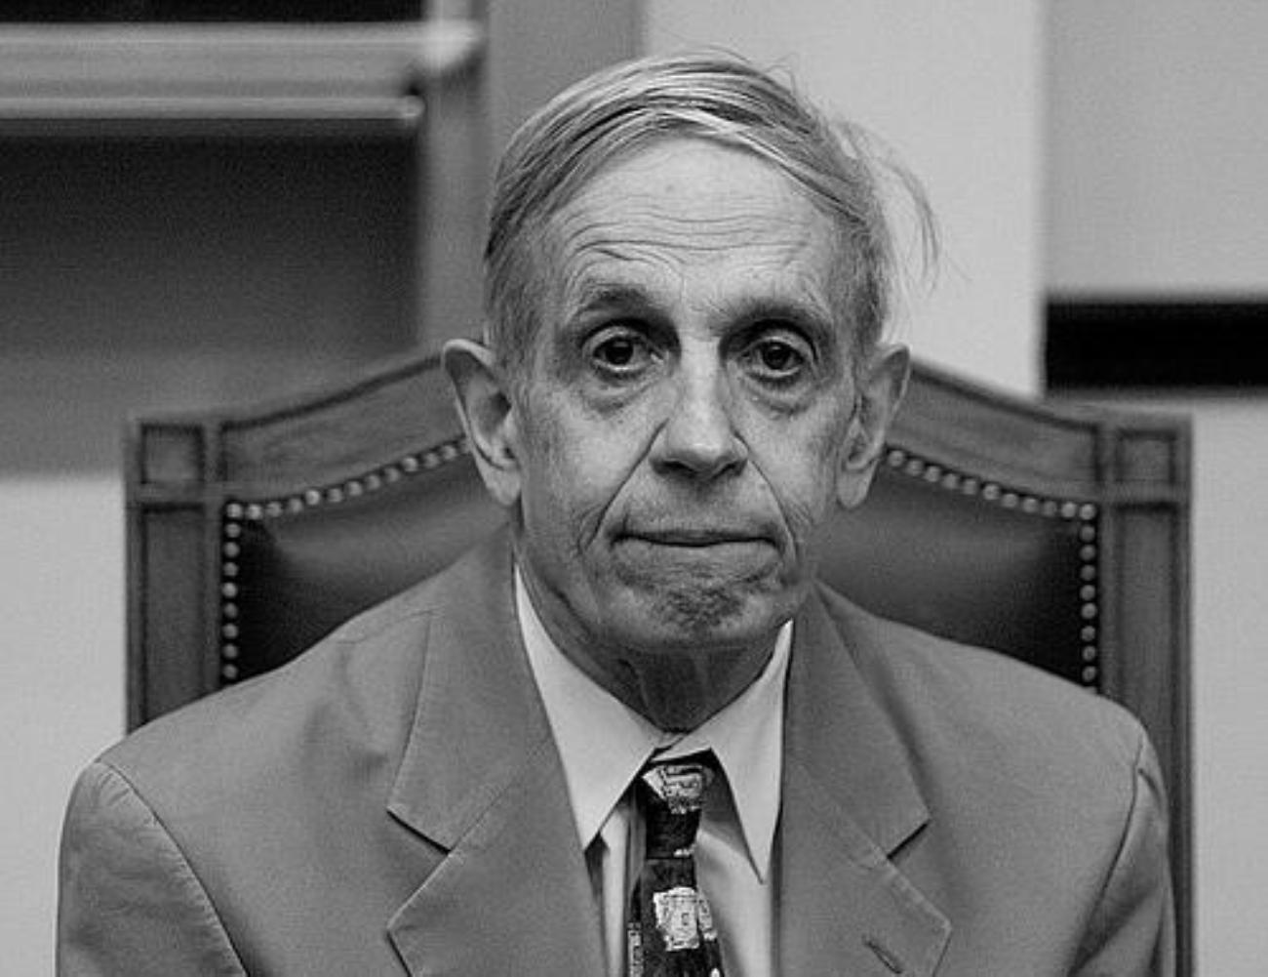
Post-War (1940s-1950s)
• Alumni of the US and UK code breaking efforts and other started building general purpose computers
• Manchester Baby
• Ferranti Mark I
• Harvard Mark I
• US Army ENIAC
1950s:
• Math / Science “Won the war”
• Mathematicians were valued, recruited , brilliant, arrogant, and quirky.

Slide 9
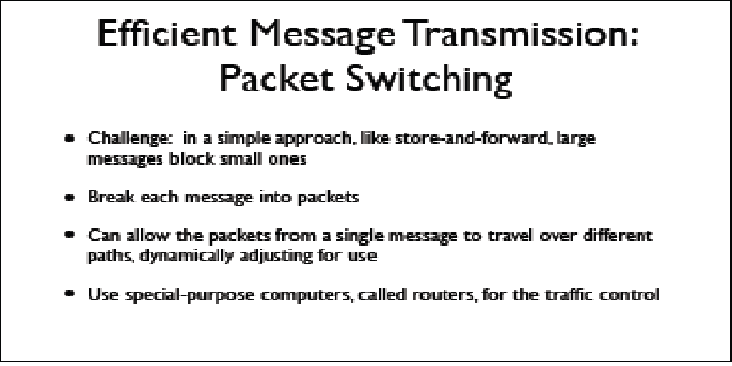
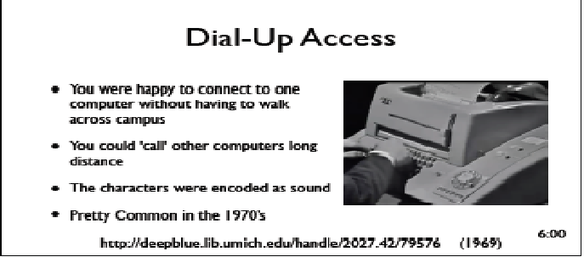
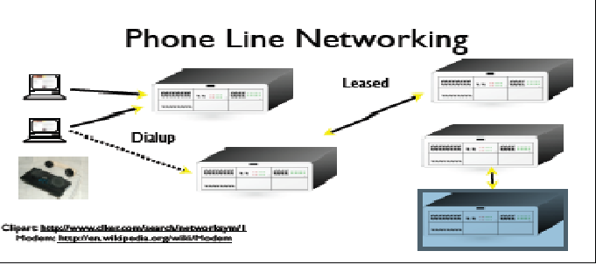
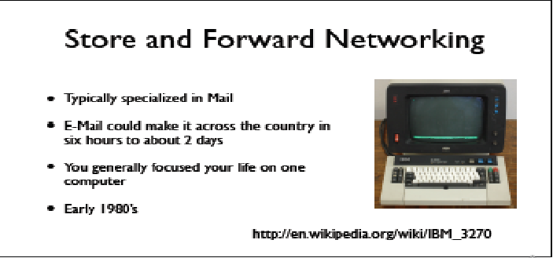

Slide 10
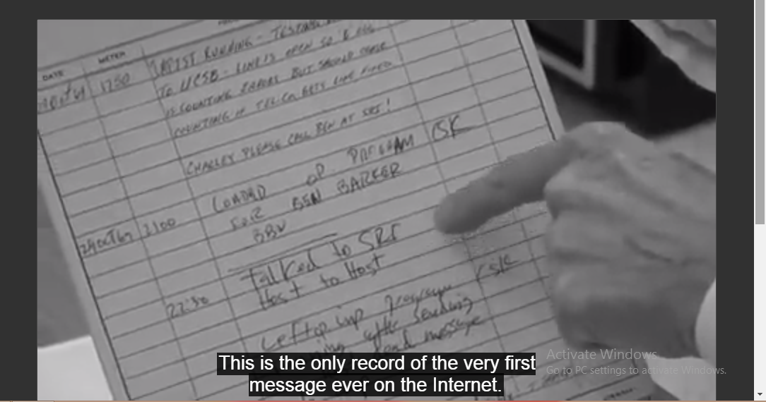
NSFNet
• NSFNet was funded by the National Science Foundation
• Standardized on TCP/IP
• Initially the goal was all research universities
• Leonard Kleinrock and Charlie Klein – First two packets on Internet (ARPANET IN 1969)
“ Lo and Behold ”

Slide 11
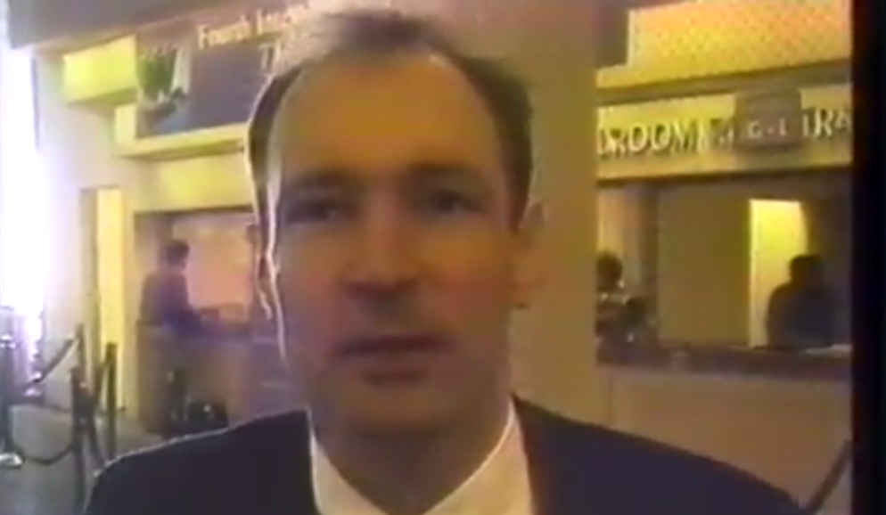
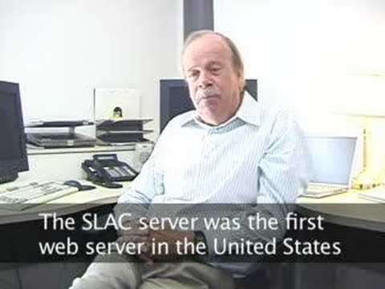
THE BEGINNING OF THE WEB : CERN
• The Internet was infrastructure -the web gave the Internet a “user interface and URLs
• The Web was invented at CERN by Tim Berners-Lee and Robert Cailliau
• Before 1994 , Gopher was dominant and easy to install.
• Dr. Paul Kunz created the first web server, first web engine SLAC in America which had 300,000 physics paper installed.
• 1994- Year of Web when Telecommunication companies made ad campaigns for this!

Slide 12
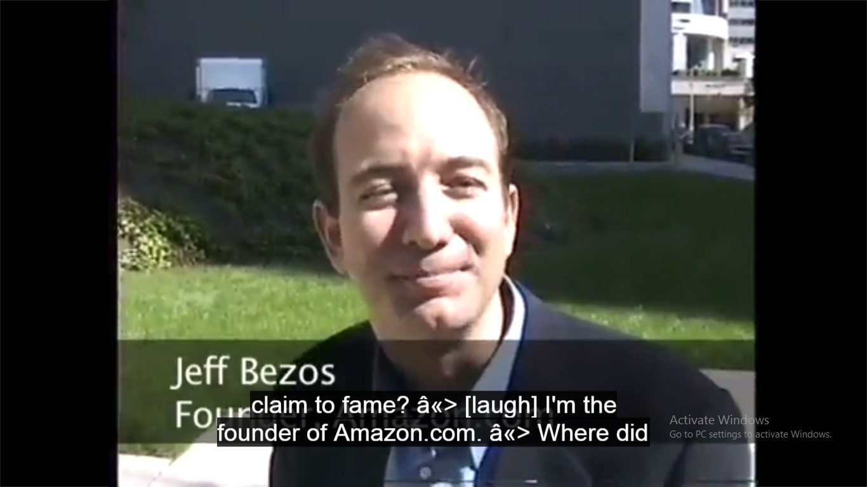
1995 - MONEY COMES AND MATTERS…!
• Competition between Netscape and Microsoft
• Javascript was developed in ten days by Netscape to trend their business.
In 1990s: HOW TO DO IT?
In late 90s: WHAT TO DO WITH IT?
• Jeff Bezos – Founder of Amazon.com

Slide 13
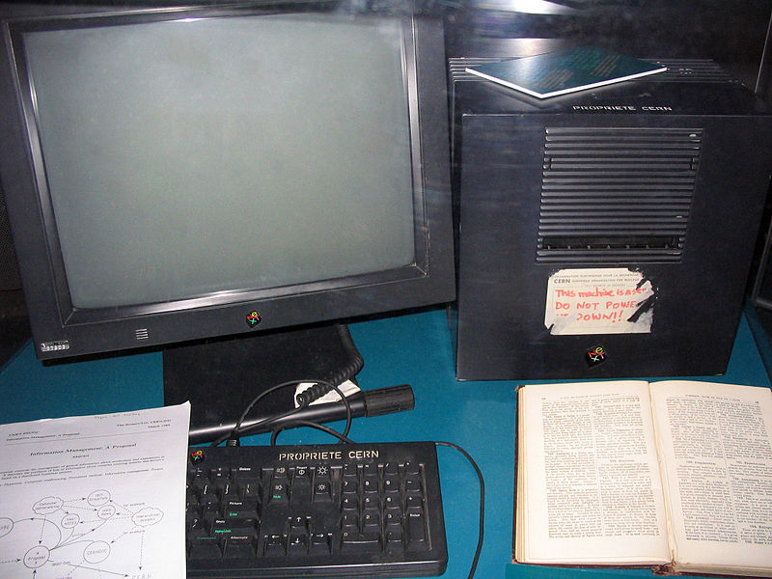
Steve Jobs and the World-Wide-Web?
• For several years the primary web browser and web server were built as NeXT applications
• Apple computers provided far superior graphics that allowed the development of Mosaic

Slide 14
Layered Network Model
Application Layer
Web, E-Mail, File Transfer
A layered approach allows the problem of designing a network to be broken into more manageable sub problems
Best-known model: TCP/IP—the “Internet Protocol Suite”
There was also a 7 layer OSI: Open System Interconnection Model
Transport Layer (TCP)
Reliable Connections
Internetwork Layer (IP)
Simple, Unreliable
Link Layer (Ethernet, WiFi)
Physical Connections
Notes:
TCP = transmission control protocol
IP = internet protocol
The 7-layer model got bogged down in committee discussions and votes and eventually died. The 4-layer model was crude but effective—less elegant, but it worked! Each level is clearly different from the other.

Slide 15
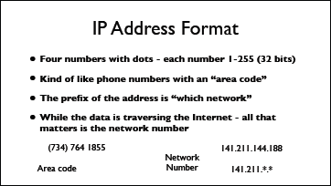
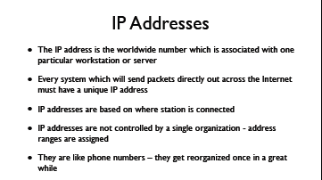
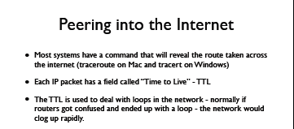
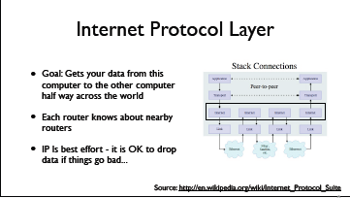
IP IS SIMPLE…….!!

Slide 16
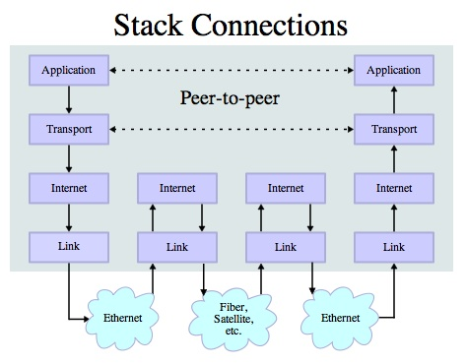
Transmission Protocol (TCP)
Built on top of IP
Assumes IP might lose some data
In case data gets lost – it keeps a copy of the data and sends until it get an acknowledgement
If it takes “too long” - just send it again

Slide 17
INTERNET SECURITY
Confidentiality - to prevent unauthorized viewing of private information
Integrity – Information is from whom you think and has not been modified since it was sent.

Slide 18
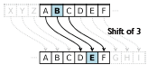
ENSURING MESSAGE CONFIDENTIALITY
Caeser Cipher
Caesar cipher is one of the simplest and most widely known encryption techniques. It is a type of substitution cipher in which each letter in the plaintext is replaced by a letter some fixed number of positions down the alphabet.

Slide 19
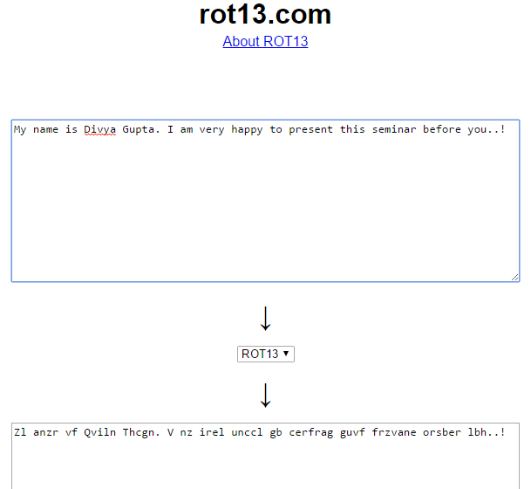
www.rot13.com

Slide 20
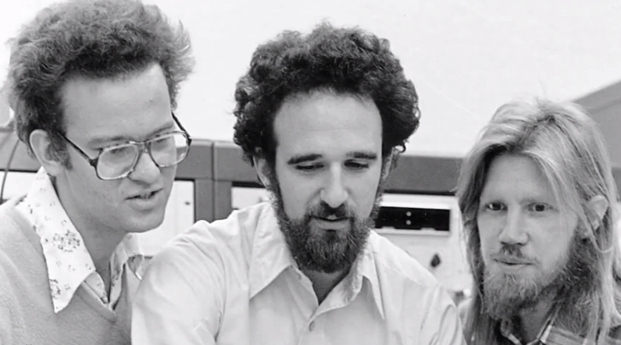
Public Key Encryption
Proposed by Whitfield Diffie and Martin Hellman in 1976
Public-key cryptosystems rely on two keys which are mathematically related to one another. Also called asymmetric-key cryptosystem.
One key is called the public key and is to be openly revealed to all interested parties.
The second key is called the private key and must be kept secret.

Slide 21
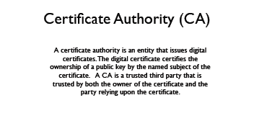
Verisign
Verisign Private Key
Amazon Public Key
Cert: Amazon
-- Verisign
Amazon Public Key
Amazon Private Key
Cert: Amazon
-- Verisign
Verisign Public Key
Amazon
Your Laptop

Slide 22
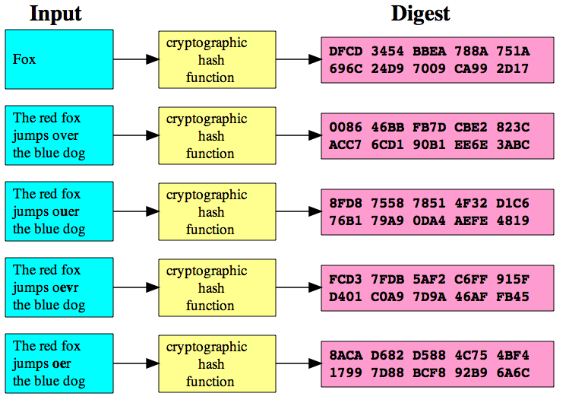
ENSURING MESSAGE INTEGRITY
Cryptographic Hash
A cryptographic hash function is a function that takes an arbitrary block of data and returns a fixed-size bit string, the (cryptographic) hash value, such that an accidental or intentional change to the data will change the hash value. The data to be encoded is often called the "message," and the hash value is sometimes called the message digest or simply digest.

Slide 23
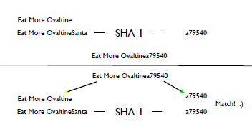
SIMPLE MESSAGE SIGNED TECHNIQUE

Slide 24
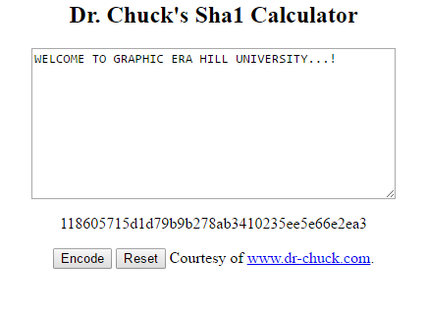
http://www.dr-chuck.com/sha1.php

Slide 25
CONCLUSION
It is said that “The Internet is the largest single engineering effort ever created by mankind”
It was created to work in an organic way - to repair itself and automatically adjust when parts fail
There is still very active exploration on how network technology can be improved
Content-Centric Networking is only one advanced idea(RECENTLY PROPOSED BY VAN JACOBSON)
Routers in the future can have *lots* of memory - lets try not to send the same piece of data more than once

Slide 26


